Slide 1
Floor Plan Generation via Generative Adversarial Networks

Slide 2
Initial Problem
Assembly Bill 68 has recently passed in California, encouraging residents to build Accessible Dwelling Units (ADUs) on their lots in order to ease California’s housing crisis. Can a data model be designed to further expedite this process?

Slide 3
Model Workflow
Generate ADU profile based on lot’s zoned area
Generate floor plan based on ADU profile
Generate furnishings based on floor plan

Slide 4
Model Workflow
Generate ADU profile based on lot’s zoned area
Generate floor plan based on ADU profile
Generate furnishings based on floor plan

Slide 5
Revised Problem Statement
Can AI be applied to floor plan analysis and generation in order to assist the design process?
Create a larger quantity of designs
Give the client a library of choices to create more interest in the process

Slide 6
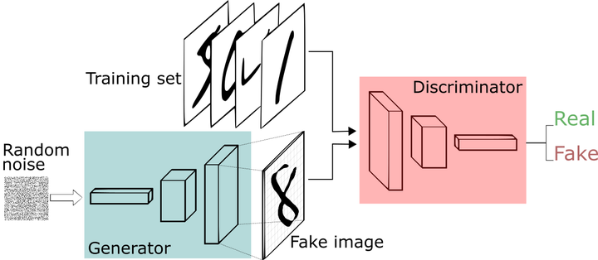
Generative Adversarial Neural Networks
Generator - creates “fakes” from the training set
Discriminator - chooses between real and “fake” and gives the generator feedback
Generator creates more relevant “fakes”
Credit: Thalles Silva

Slide 7
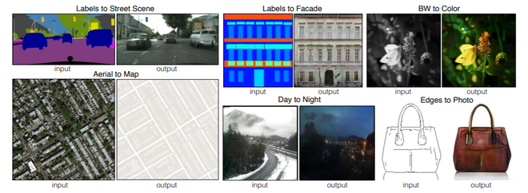
pix2pix
Conditional GAN
Generator uses training data
Uses L1 and gen/disc loss as internal metrics
Credit: pix2pix Github

Slide 8
Programming
The building’s use, its rooms’ use, and
the spatial interplay between rooms
Specifically looking at ADU programming
Important metric to judge generated floor plans

Slide 9
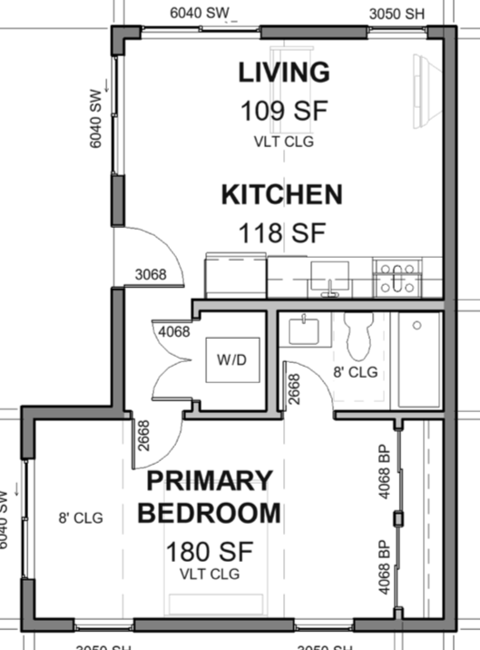
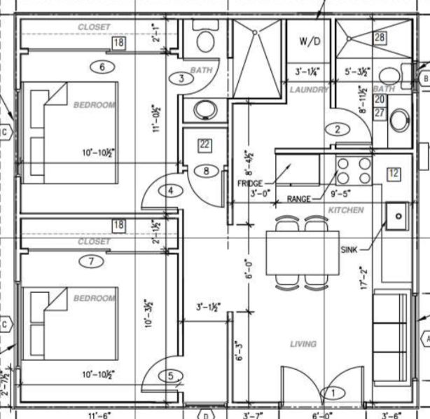
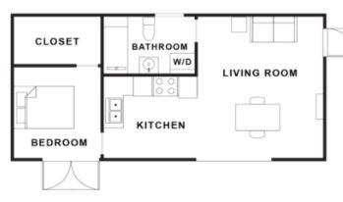
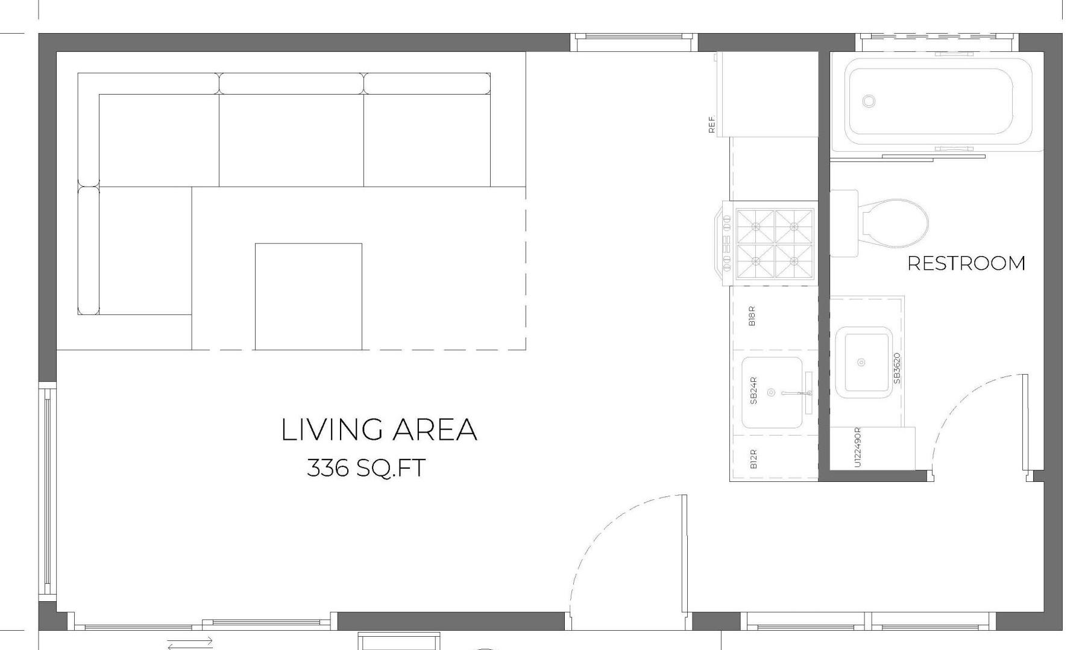
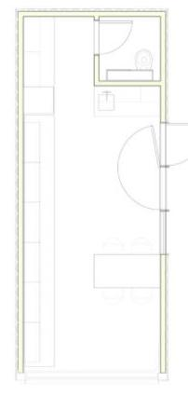
Dataset
200 Floor plans
15 sources
Buried along other building photos
No one source big enough for data scraping
Wide variety of styles

Slide 10
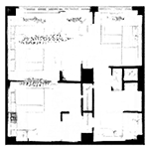
Dataset
200 Floor plans
15 sources
Buried along other building photos
No one source big enough for data scraping
Wide variety of styles

Slide 11
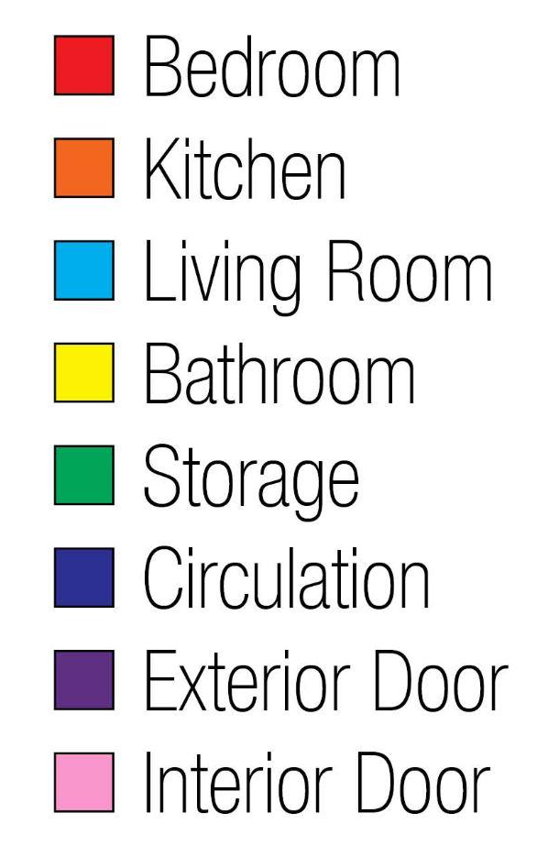
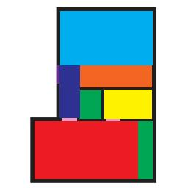
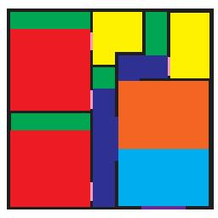
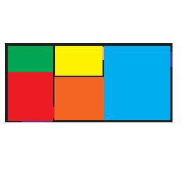
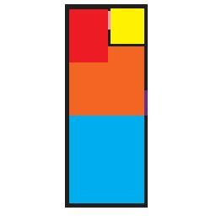
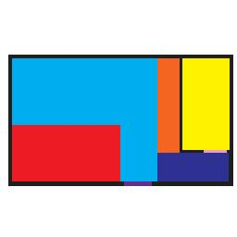
Dataset
200 Floor plans
15 sources
Buried along other building photos
No one source big enough for data scraping
Wide variety of styles

Slide 12
Metrics
Disc/Gen Loss
Neither model should “win”
Spikes are good
log(2) = 0.69. Good reference point for losses
Disc Loss < .69 - Discriminator is doing better than 50/50 at guessing between real and fake images
Gen Loss < .69 - Generator is fooling the discriminator
L1 Loss
As training progresses, L1 Loss should go down
Left vague at what the rate should be
No discernment between any models
Eyeball Test
Most important metric
Images should clean and crisp
Layout should make sense programmatically
Images indiscernible from training image quality

Slide 13
Eyeball Metrics
Poor
Mess of a layout
No ability to tell what rooms should be
Average
Some order programmatically
Rooms consistently not well defined
Good
Good program definition overall, with few obvious mistakes
Only needs quick touch-up to be excellent
Excellent
Indiscernible from training set
Some smudges acceptable
Could be shown to a client

Slide 14
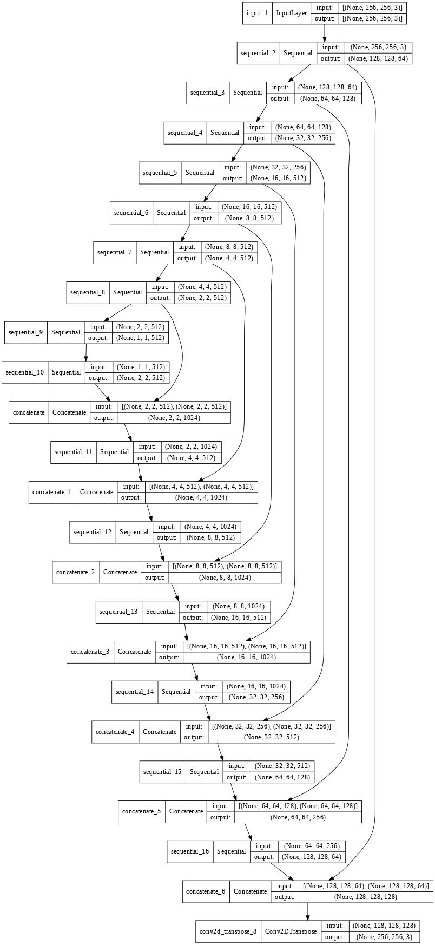
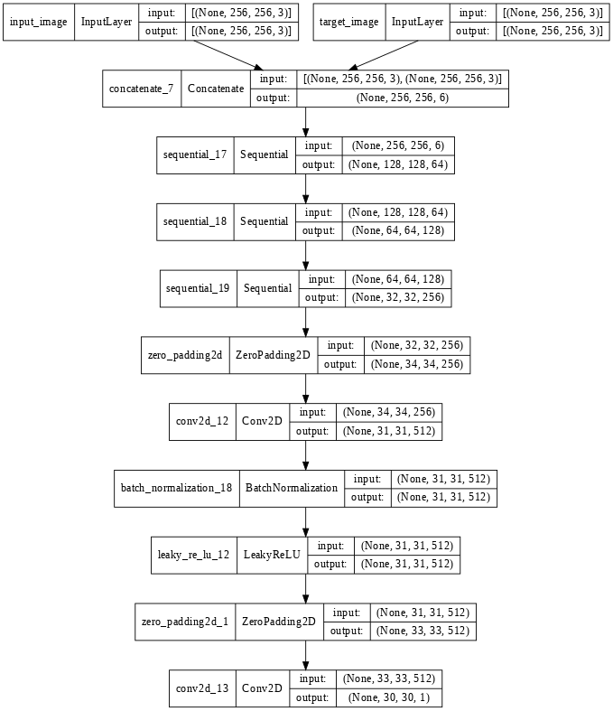
Generator
Discriminator

Slide 15
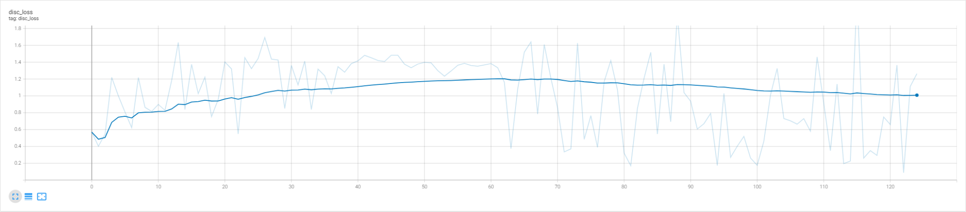
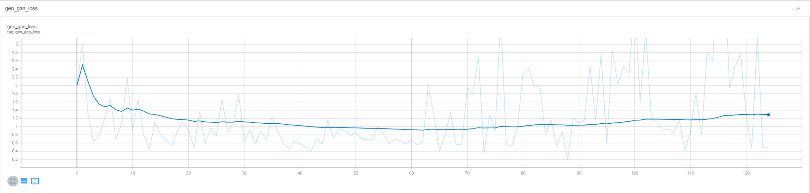
Model One - 125 Image Dataset

Slide 16
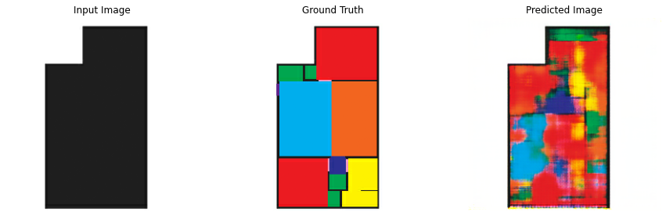
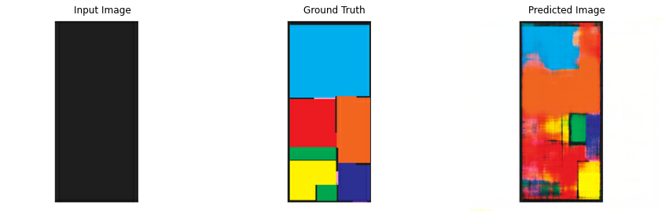
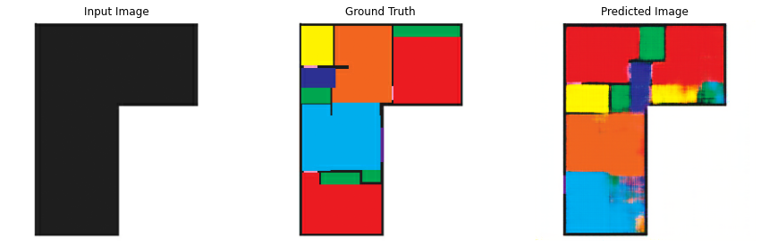
Model One - 125 Image Dataset
 | Poor | Average | Good | Excellent
Total | 13 | 8 | 4 | 0
Percent | 52% | 32% | 16% | 0%
Poor
Average
Good

Slide 17
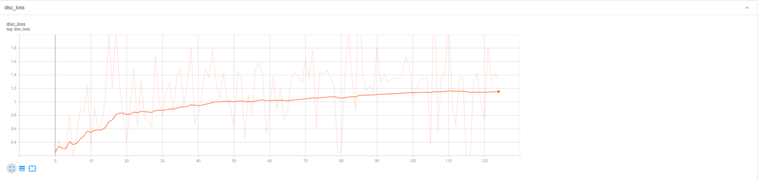
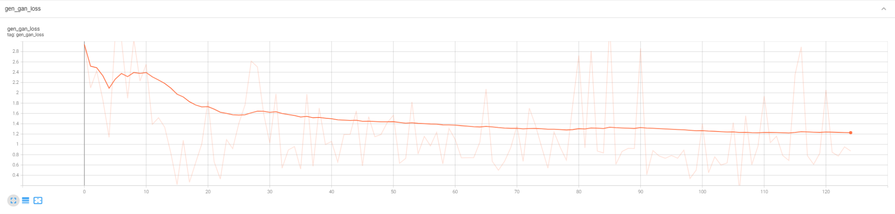
Model Two - 200 Image Dataset

Slide 18
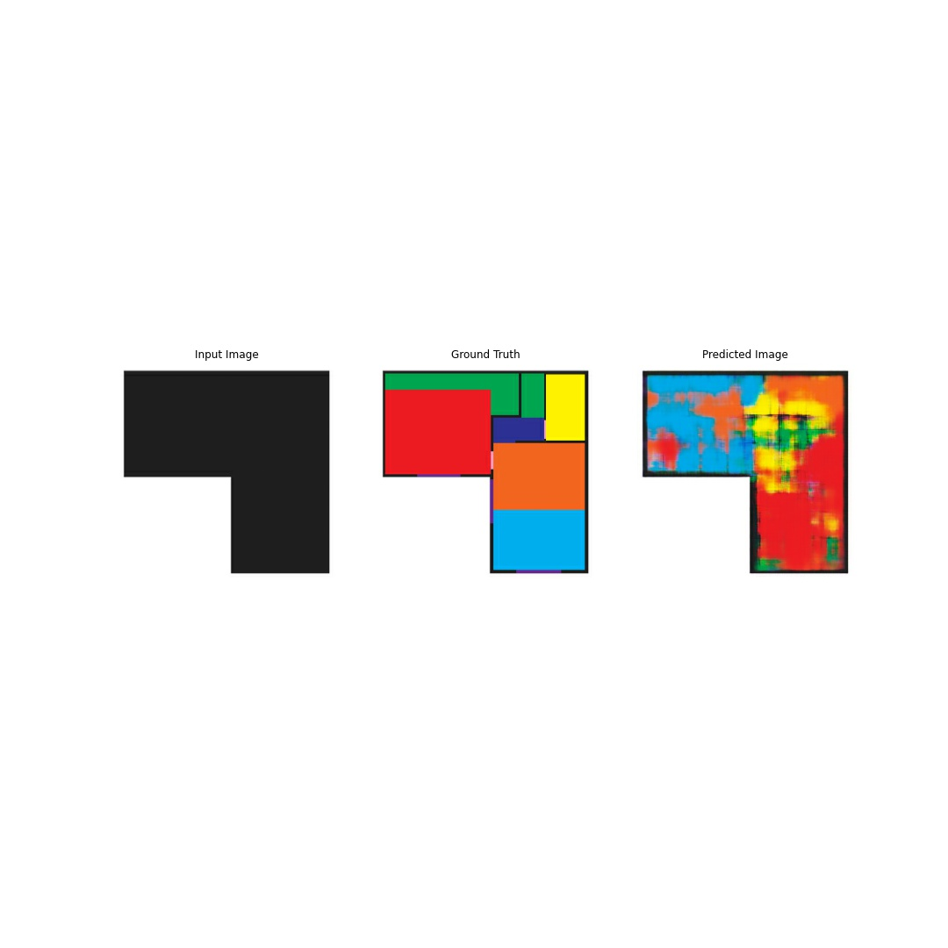
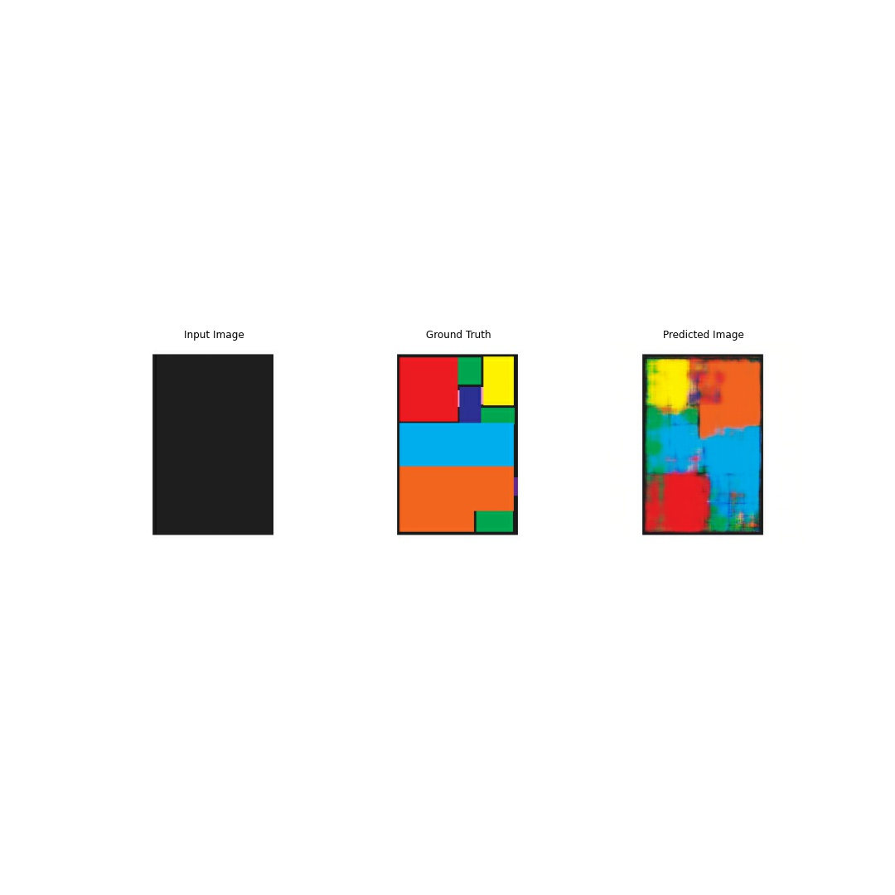
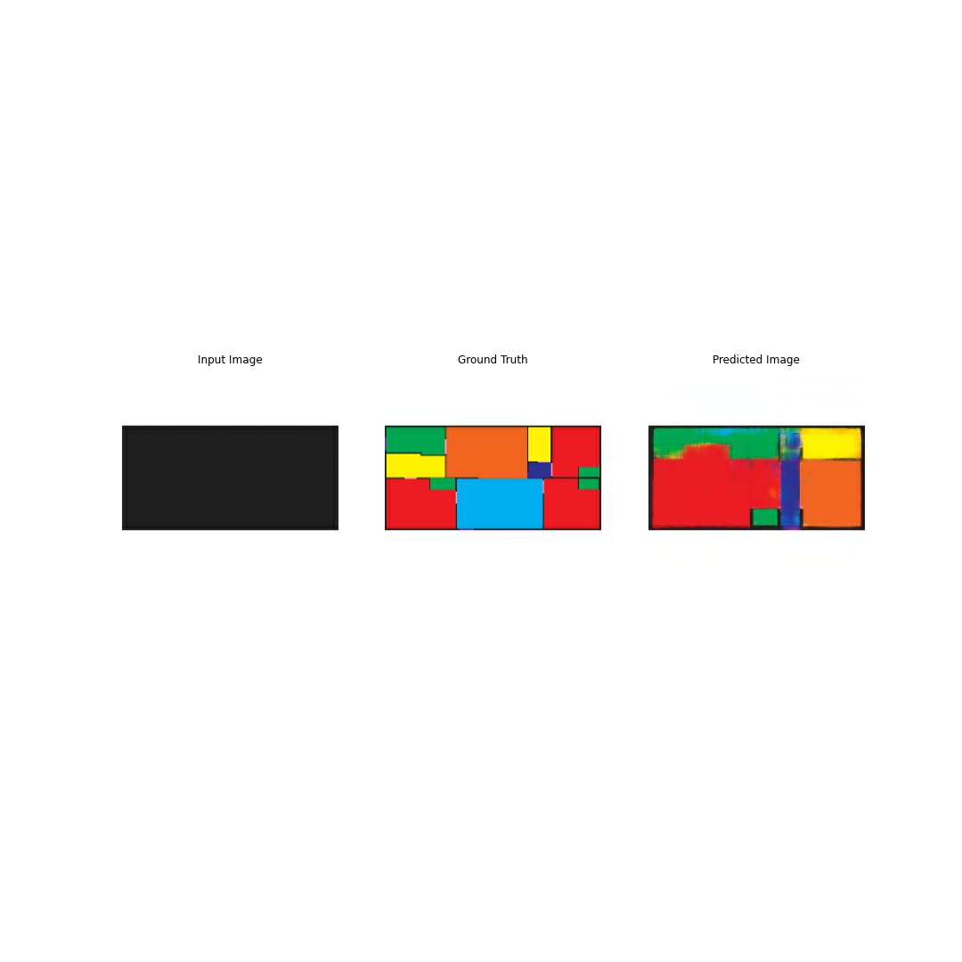
Model Two - 200 Image Dataset
 | Poor | Average | Good | Excellent
Total | 3 | 11 | 18 | 8
Percent | 7.5% | 27.5% | 45% | 20%
Poor
Average
Good

Slide 19
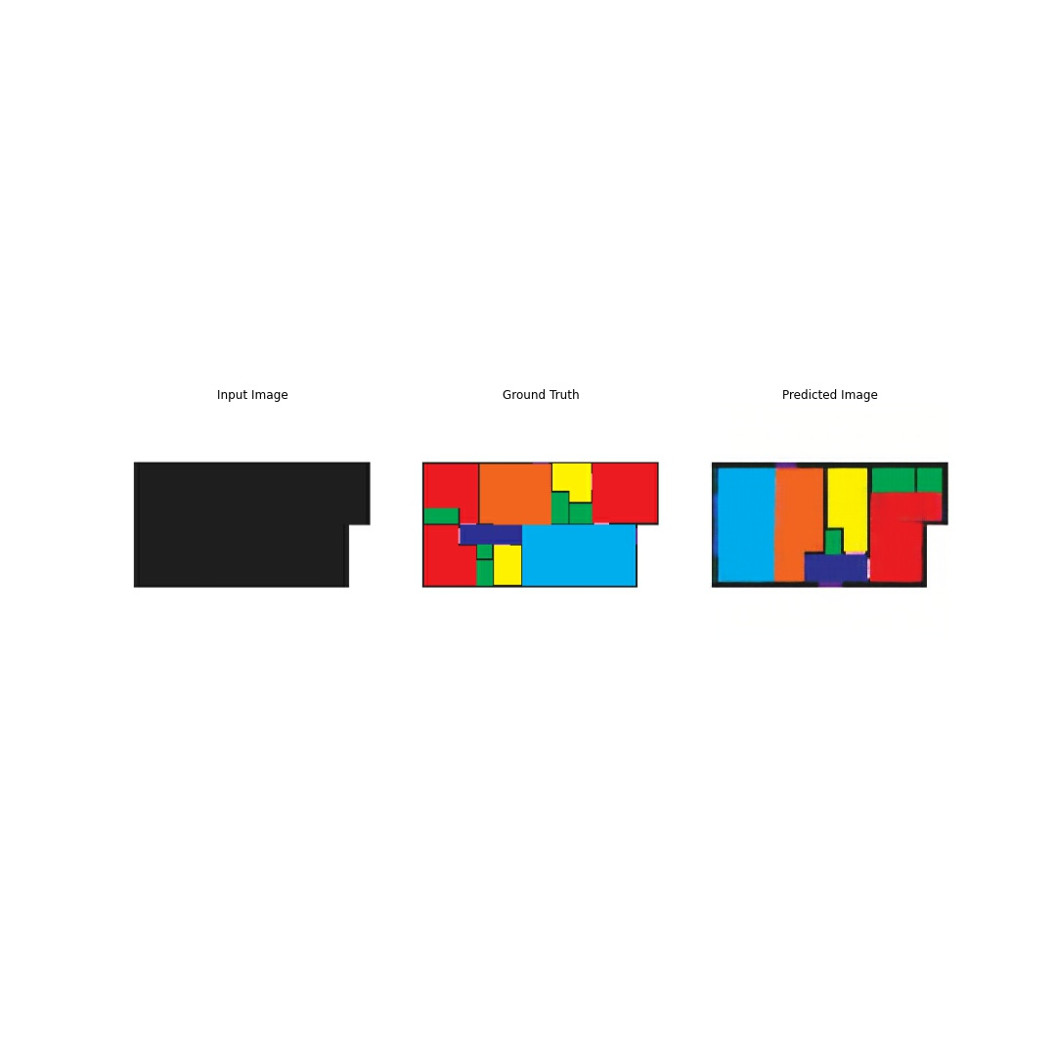
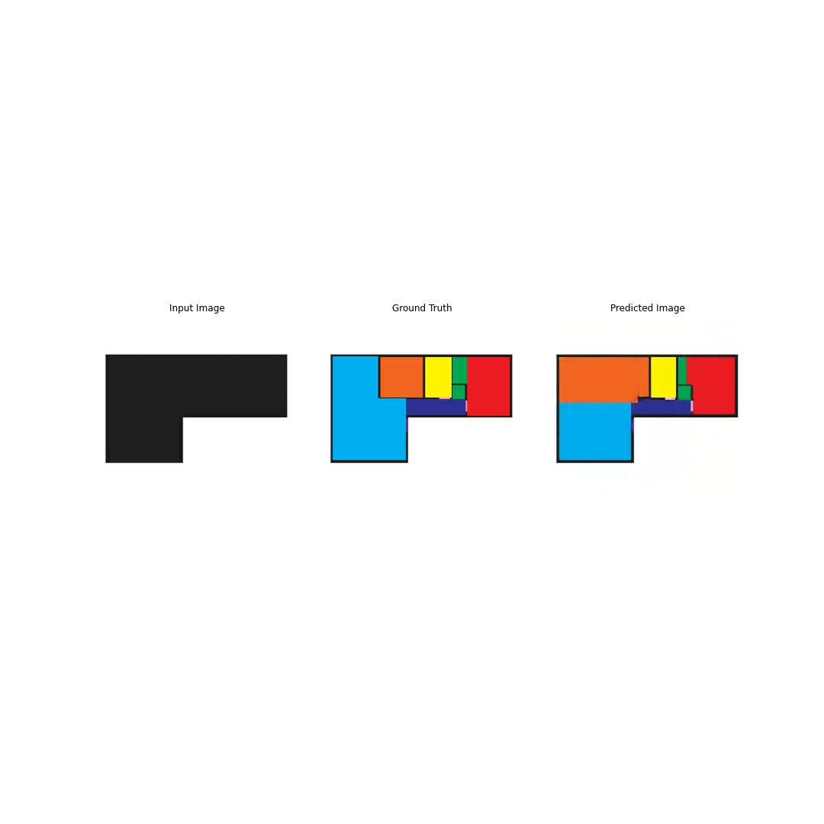
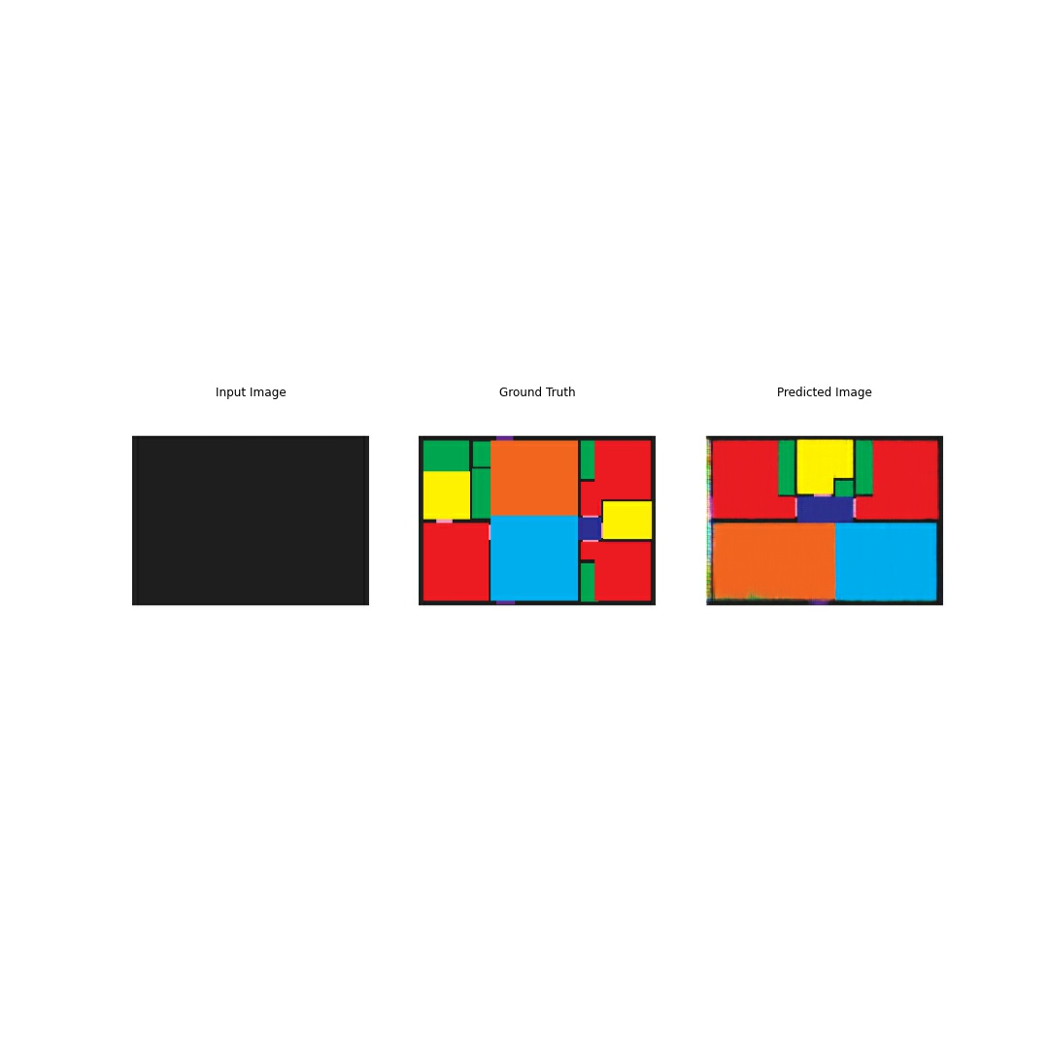
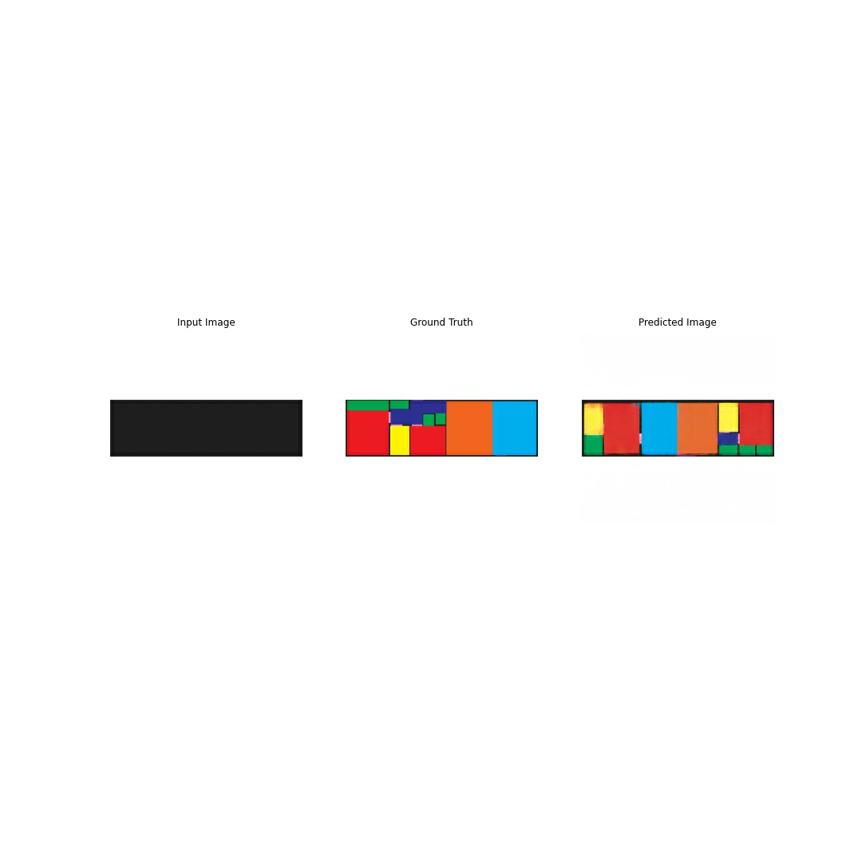
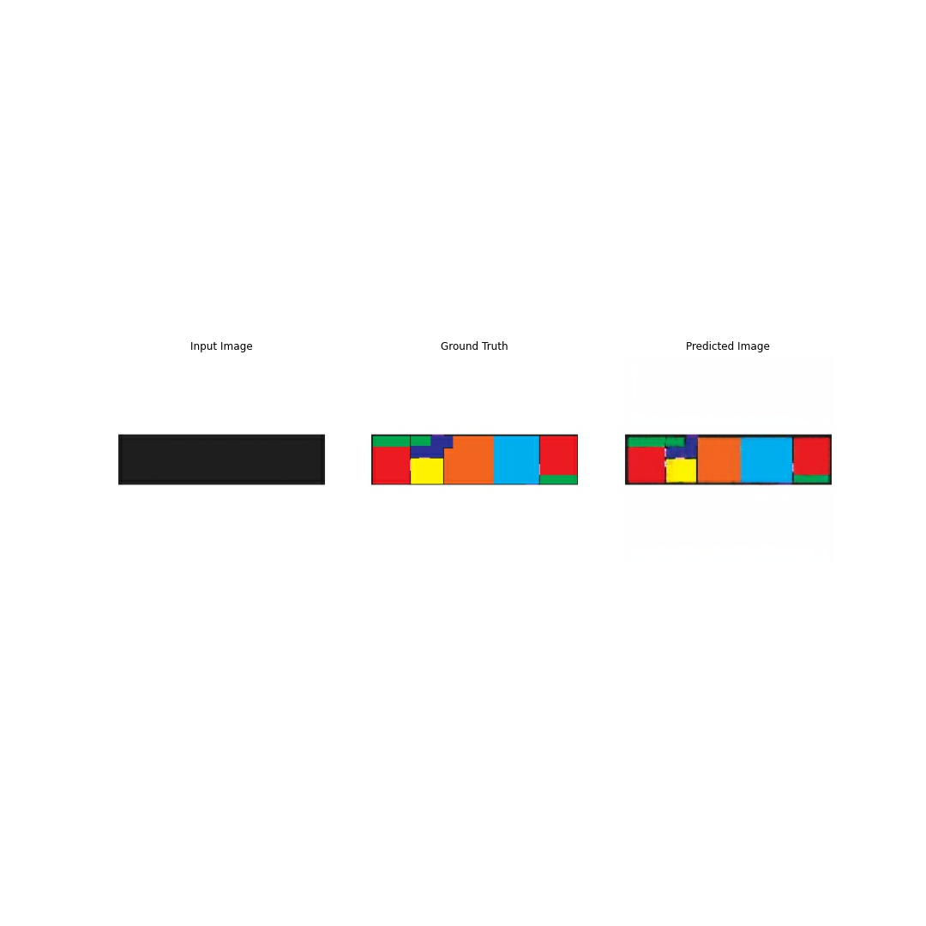
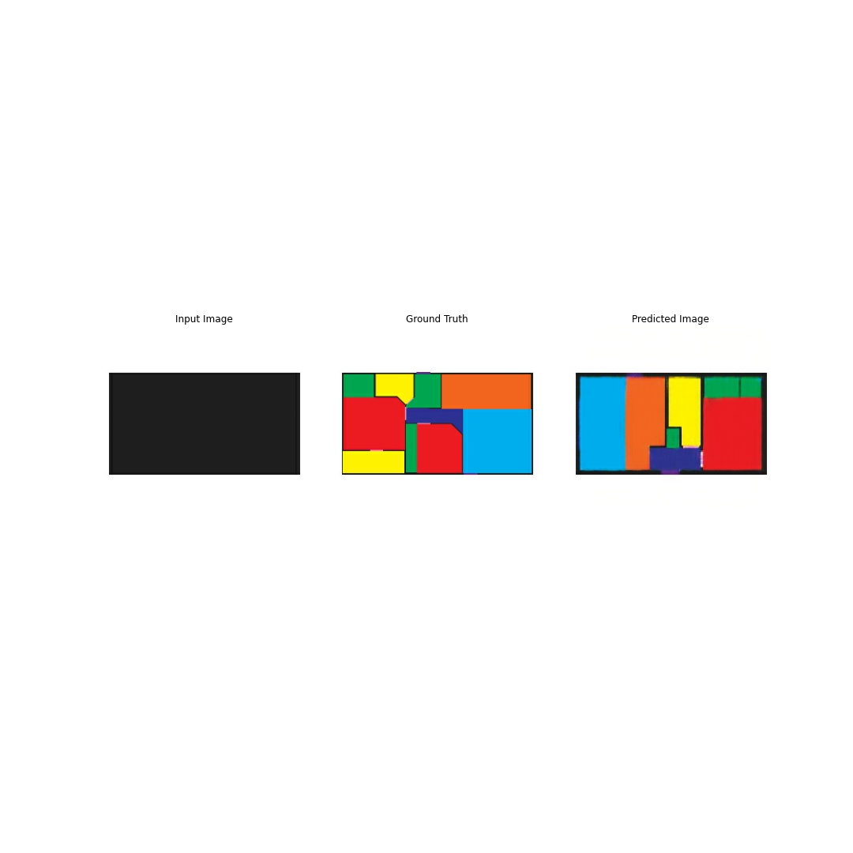
Model Two - Excellent Images

Slide 20
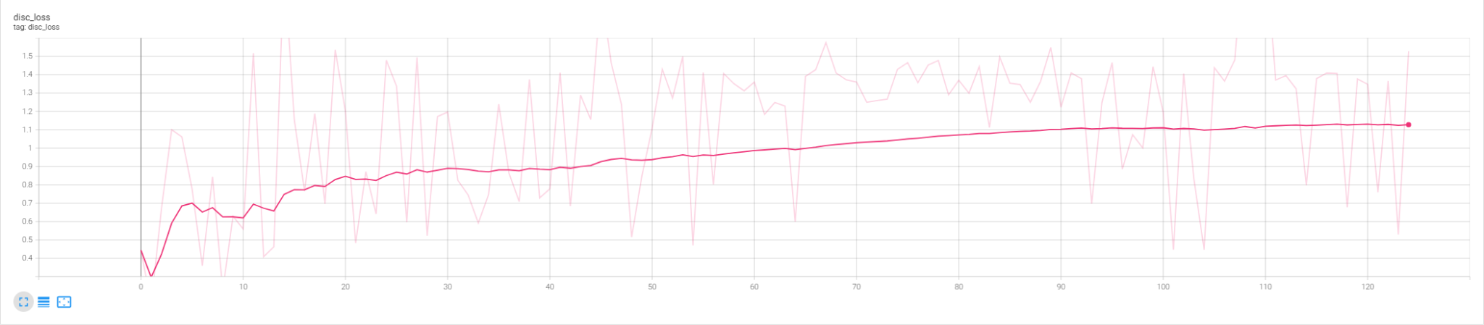
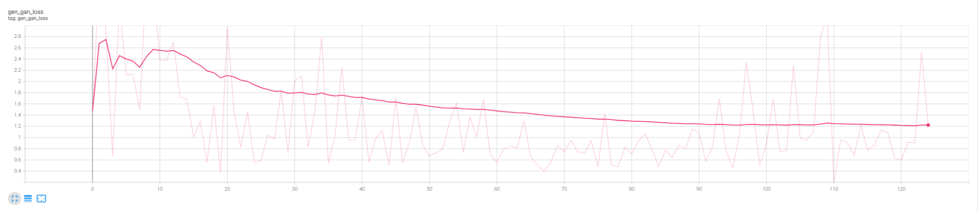
Model Three - 200 Image Extended Dataset

Slide 21
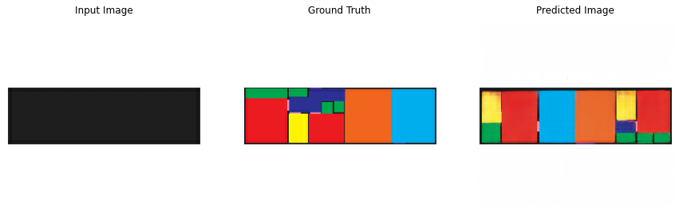
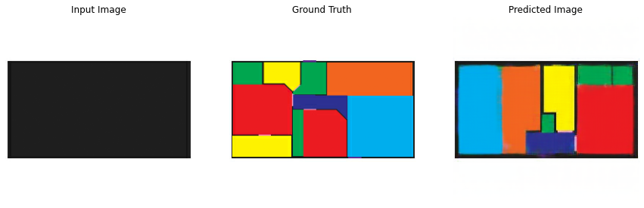
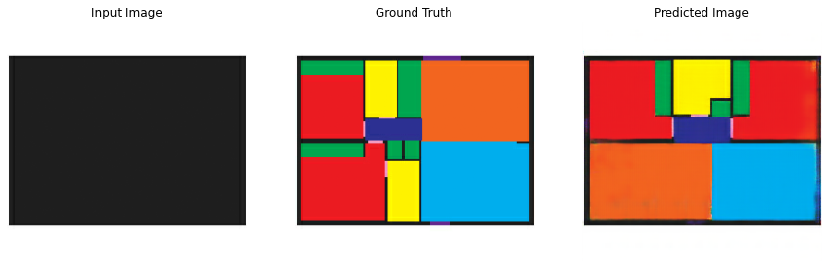
Model Three - 200 Image
Extended Dataset
 | Poor | Average | Good | Excellent
Total | 15 | 15 | 2 | 8
Percent | 37.5% | 37.5% | 5% | 20%
Excellent Models

Slide 22
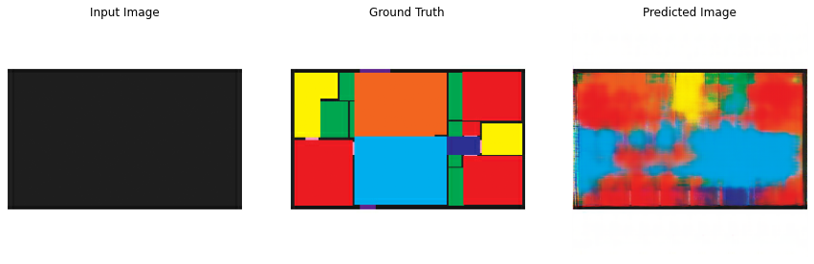
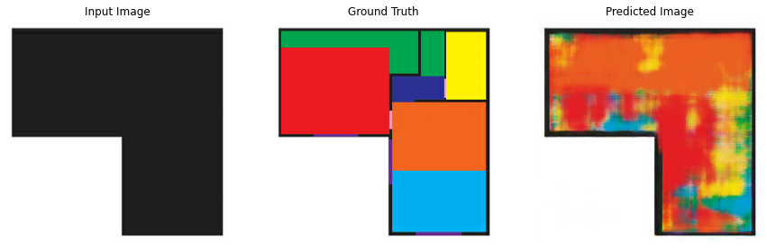
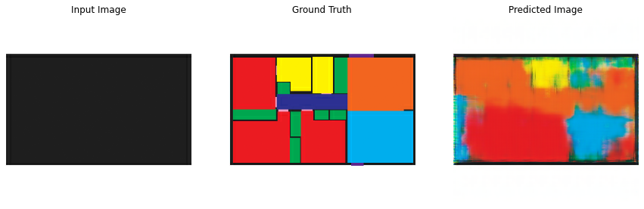
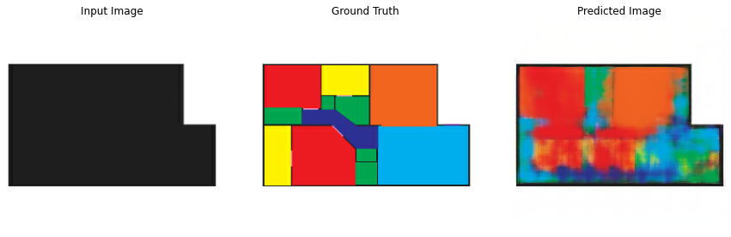
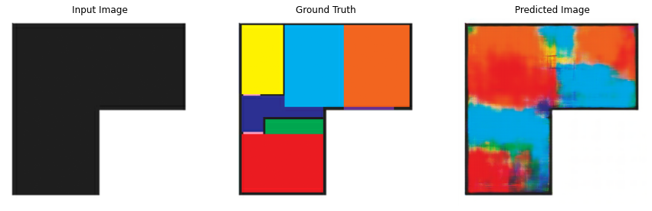
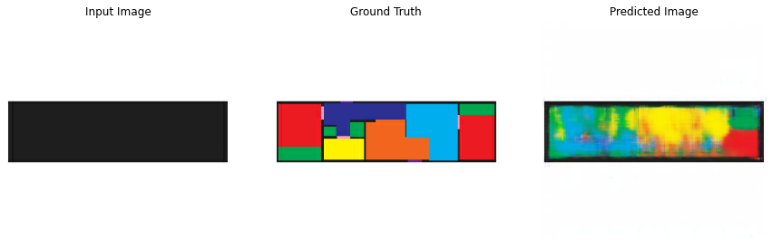
Model Three - Washed Out Images

Slide 23
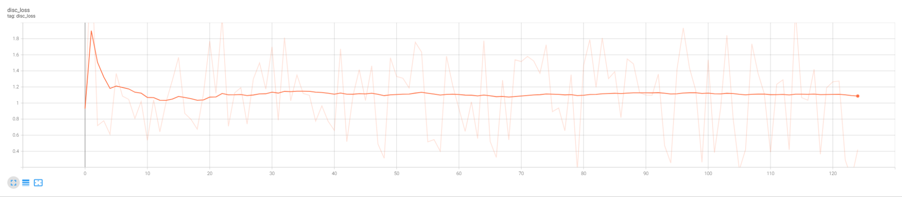
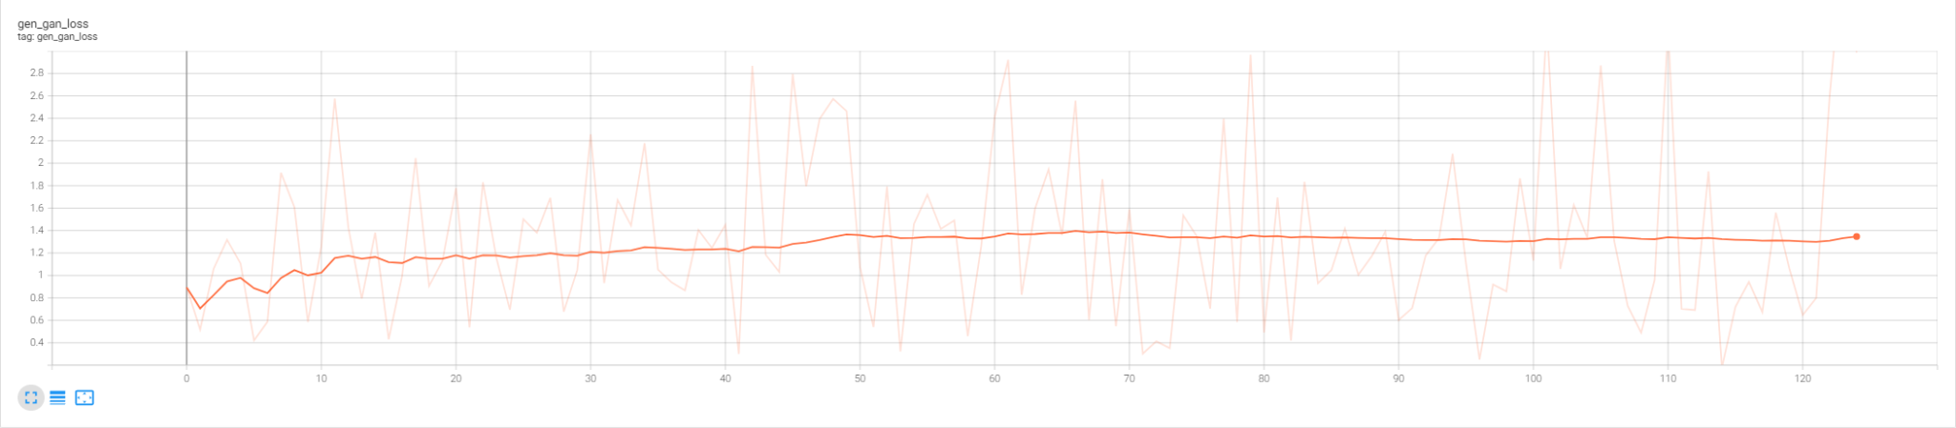
Model Four - Simple Image Dataset

Slide 24
Model Four - Simple Image
Dataset
 | Poor | Average | Good | Excellent
Total | 13 | 12 | 5 | 6
Percent | 36.11% | 33.33% | 13.89% | 16.67%
Poor
Average
Good

Slide 25
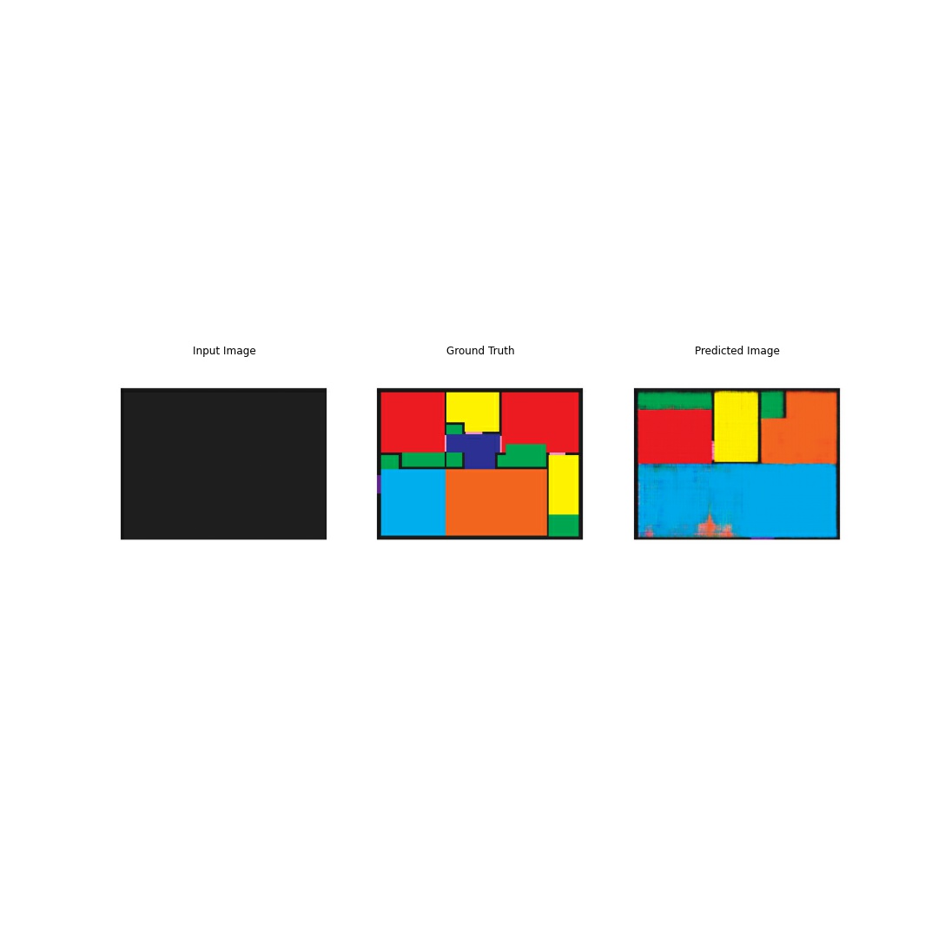
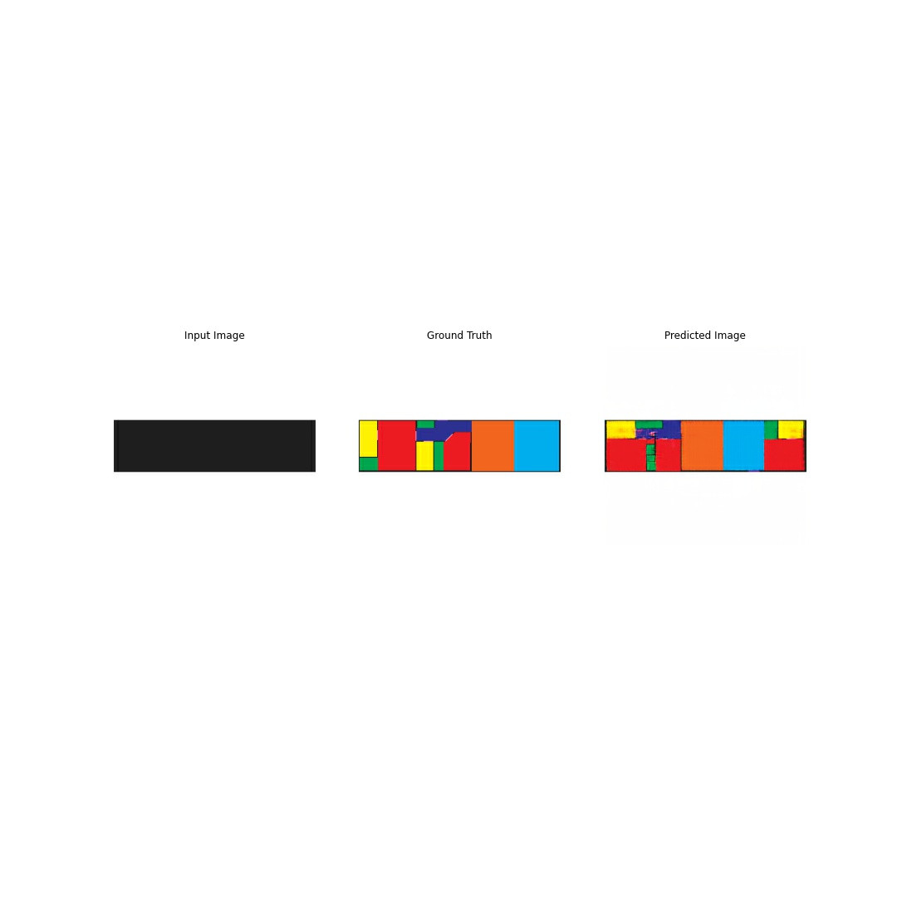
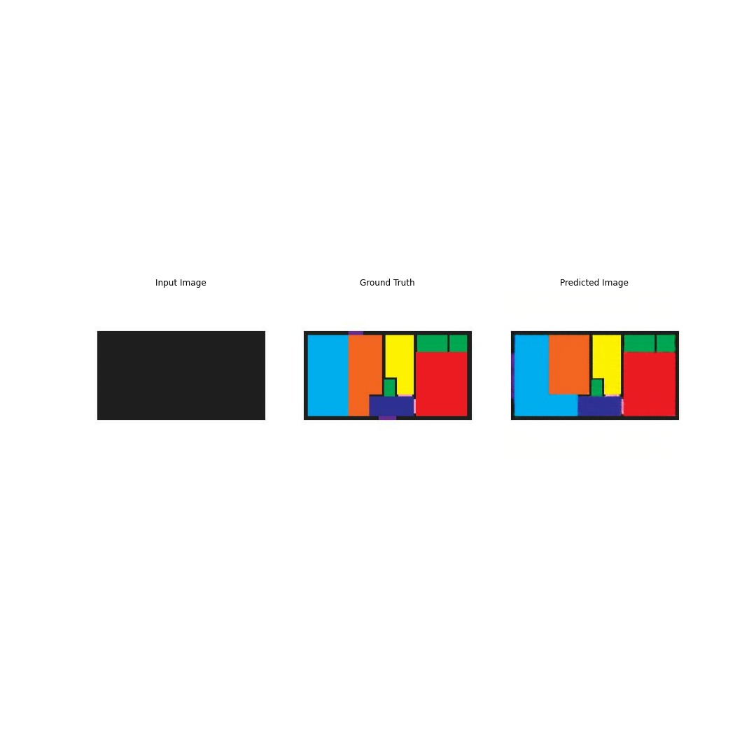
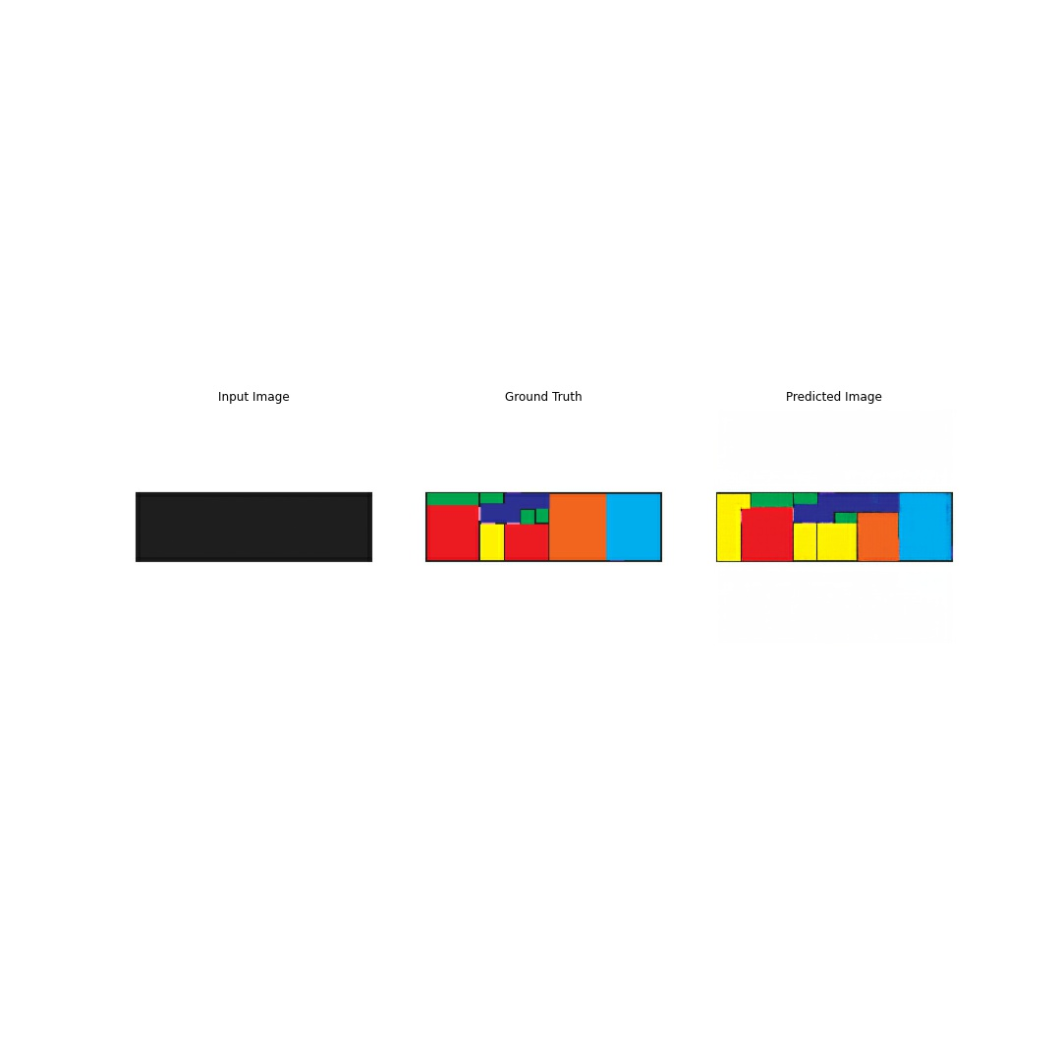
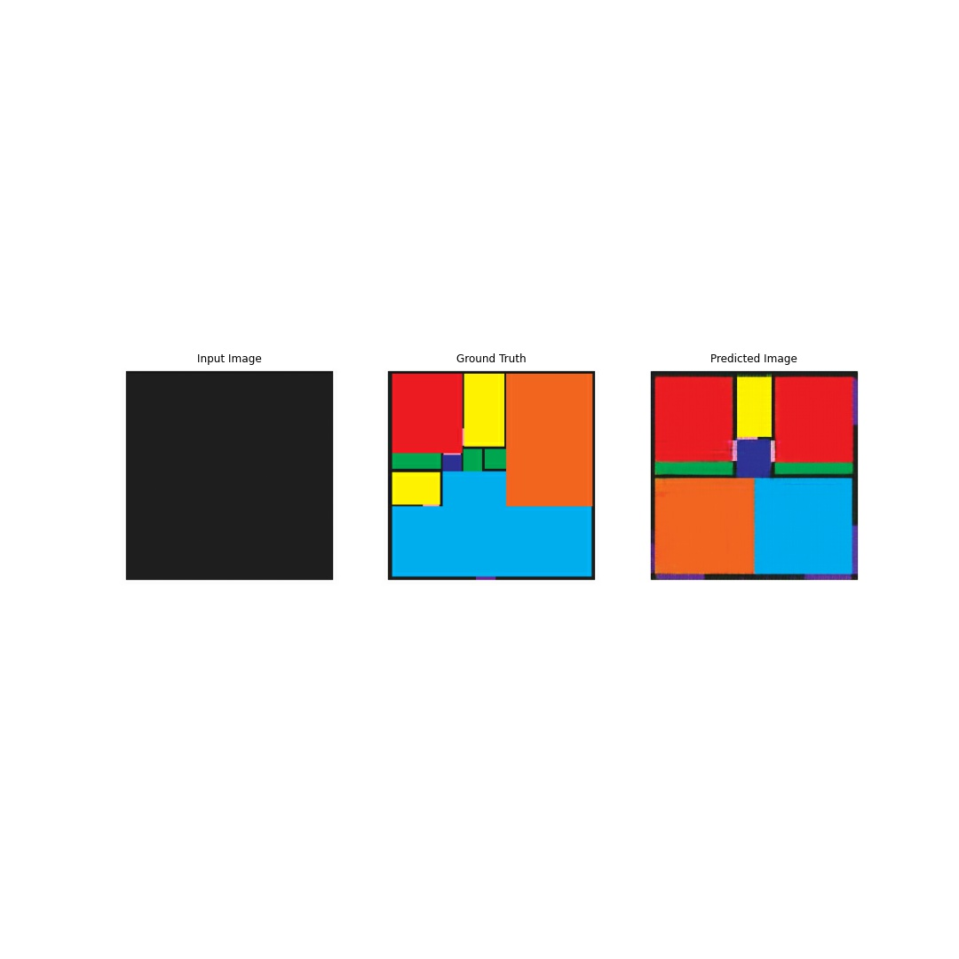

Model Four - Excellent Images

Slide 26



Model Five - Exterior Doors
Dataset
 | Poor | Average | Good | Excellent
Total | 10 | 19 | 7 | 4
Percent | 25% | 47.5% | 17.5% | 10%
Average
Good
Excellent

Slide 27


Model Five - Coloring Outside the Lines

Slide 28


Model Six - Tricky Dataset

Slide 29



Model Four - Tricky Dataset
 | Poor | Average | Good | Excellent
Total | 40 | 0 | 0 | 0
Percent | 100% | 0% | 0% | 0%

Slide 30






Model 6 - Illegible Images

Slide 31
Insights
Model shows a lot of promise
Biggest improvements came from adding more data
No improvements from modifying disc/gen
Inputs not matching training set drops off greatly
Model prone to overfitting

Slide 32
Next Steps
Model needs more data
Apartments/cabins
Create my own floor plans
Disc/gen optimization
Could look at a cycle GAN
Look into other aspects of ADU modeling
Create a model with no floor plan discrimination

Slide 33
Credits
Websites: snapadu.com/snapadu.com/, https://www.delmar.ca.us/815/ADU-Sample-Floor-Plans, https://www.hybridcorehomes.com/adu/, https://proteus.homes/floor-plans/, https://superioradus.com/, https://www.sandiegocounty.gov/content/sdc/pds/bldg/adu_plans.html, https://www.ladbs.org/adu/standard-plan-program/approved-standard-plans, https://adore-homes.com/models/, https://villahomes.com/units/#1-bedroom, https://abodu.com/quickship/, https://www.cotta.ge/, https://adumarin.org/floorplans, https://www.dwell.com/article/adu-floor-plans-06b805c4, https://maxablespace.com/accessory-dwelling-unit-floor-plans/, https://www.modernaduplans.com/adu-plans
pix2pix Tutorial: https://www.tensorflow.org/tutorials/generative/pix2pix

Slide 34





















